Slide 1

Programming Two (csc7051)
Aidan McGowan
Files and Steams

Slide 2
Files
Data stored in variables and arrays is temporary—it’s lost when a local variable goes out of scope or when the program terminates. For long-term retention of data, even after the programs that create the data terminate, computers use files.
Data maintained in files is persistent data—it exists beyond the duration of program execution.

Slide 3

Files and Streams
Java views each file as a sequential stream of bytes
Every operating system provides a mechanism to determine the end of a file, such as an end-of-file marker or a count of the total bytes in the file

Slide 4
Standard Input, Standard Output and Standard Error Streams
A Java program opens a file by creating an object and associating a stream of bytes or characters with it. The object’s constructor interacts with the operating system to open the file.
Java has steam objects that enable communication to various devices…
  System.in (normally enables a program to input bytes from the keyboard)
  System.out (normally enables a program to output character data to the screen)
  System.err (normally enables a program to output errors)
All can be redirected. For example, System.in to read from a file and System.out and System.err to write to a file.
Notes:
public static void main(String[] args) {
System.out.println("Out to screen");
System.err.println("An error message");
int inNum;
try {
inNum = System.in.read();
System.out.println("I read a : " + (char) inNum);
} catch (IOException e) {
e.printStackTrace();
}
}

Slide 5
The java.io Package
Java programs perform file processing by using classes from package java.io. This package includes definitions for stream classes, such as FileInputStream, FileOutputStream, FileReader, FileWriter.
In addition to the java.io classes, character-based input and output can be performed with classes Scanner and Formatter.
  Class Scanner is used extensively to input data from the keyboard—it can also read data from a file.
  Class Formatter enables formatted data to be output to any text-based stream in a manner similar to method System.out.printf.

Slide 6
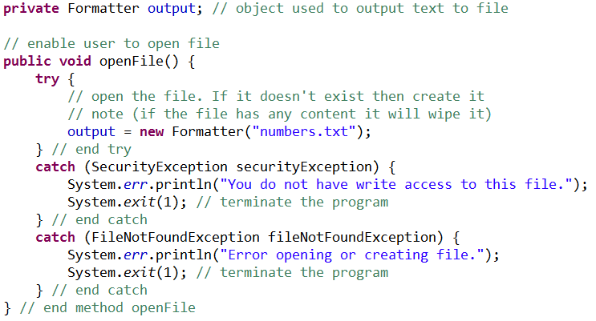
Create/open a text file – using Formatter class
The Formatter class (java.util) can be used to open/ create and write to a file..
File to be at root of project

Slide 7
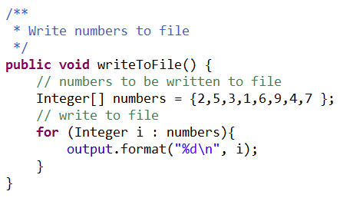
Write to a text file – using Formatter class
Write to a file..(continued from previous slide)

Slide 8
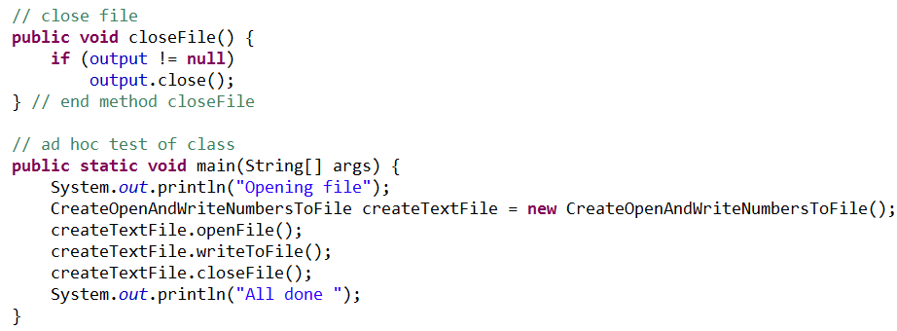
Write to a text file – using Formatter class
Remember to close all resources.

Slide 9
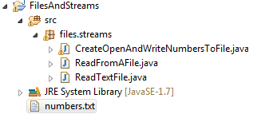
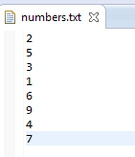
Output …

Slide 10
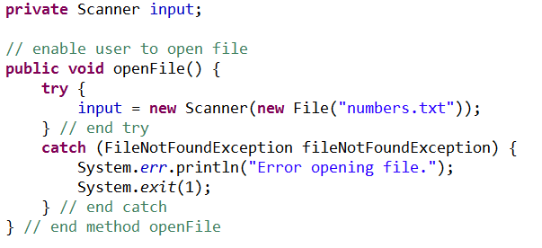
Read from a file
Using scanner open and eventually read from the file

Slide 11
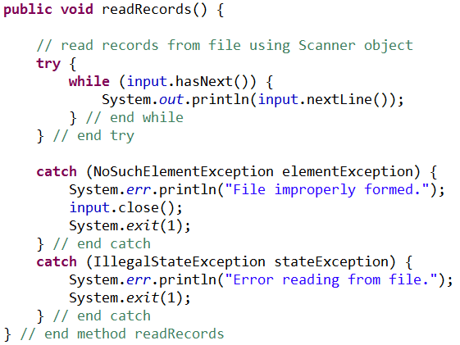
Read from a file
Scanner read from file

Slide 12
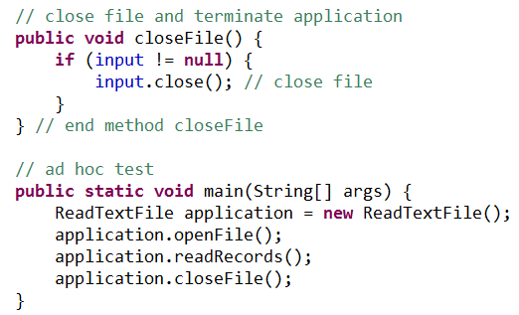
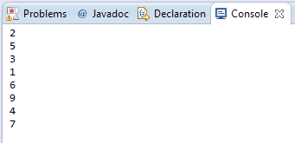
Read from a file
Remember to close all resources

Slide 13
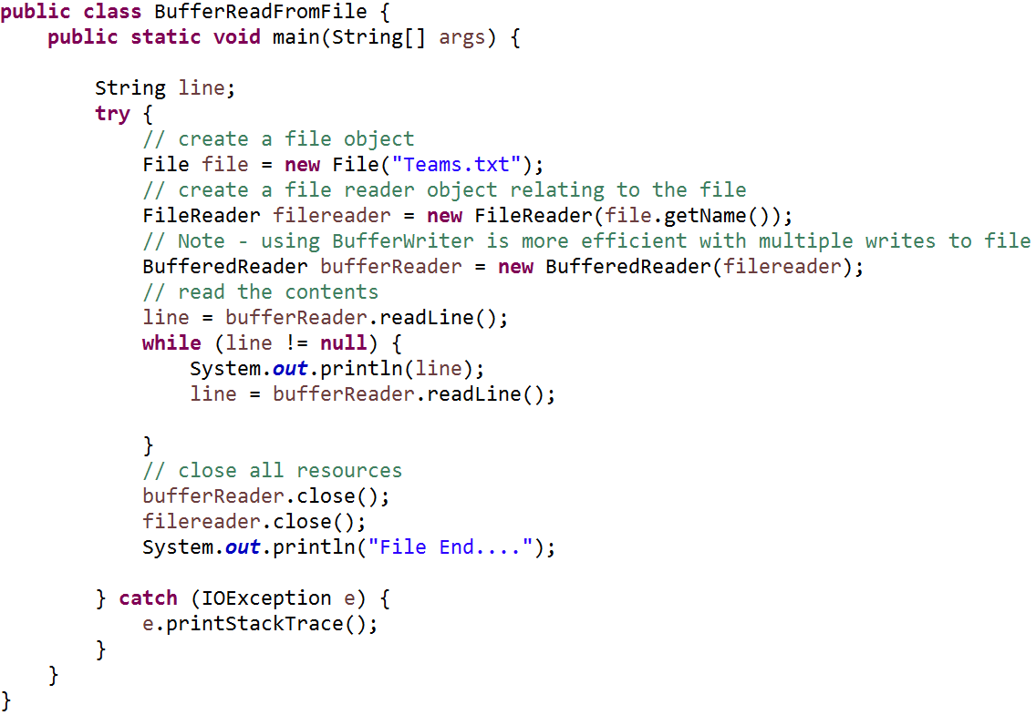
Buffered reading from file

Slide 14

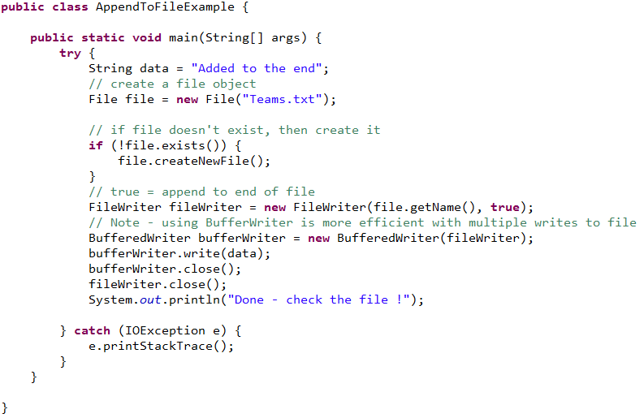
Buffered Appending (writing) to a file

Slide 15
Exercise – create, open, sort and rewrite sort to file
Write a program that will prompt the user for a series of numbers. (limit to 5 numbers)
Sort the numbers in ascending ordered
Write the sorted numbers to file.
Notes:
package playTime;
import java.io.BufferedWriter;
import java.io.File;
import java.io.FileWriter;
import java.io.IOException;
import java.util.ArrayList;
import java.util.Collections;
import java.util.Scanner;
public class NumberResponses {
public static void main(String[] args) {
// arraylist to hold the numbers
ArrayList<Integer> numbers = new ArrayList<Integer>();
// scanner to get user input
Scanner sc = new Scanner(System.in);
// assuming 5 numbers ...
for (int loop = 0; loop < 5; loop++) {
System.out.println("Enter number ...");
numbers.add(sc.nextInt());
}
System.out.println(numbers.toString());
// sort the numbers
Collections.sort(numbers);
System.out.println(numbers.toString());
// open or create file
File file = new File("InputNumbers.txt");
if (!file.exists()) {
try {
file.createNewFile();
} catch (IOException e) {
// TODO Auto-generated catch block
e.printStackTrace();
}
}
try {
// write to the file
FileWriter fw = new FileWriter(file, true);
BufferedWriter bw = new BufferedWriter(fw);
bw.write(numbers.toString());
bw.close();
fw.close();
} catch (IOException e) {
e.printStackTrace();
}
}
}

